Slide 1
Reading Adoption 2021-22

Slide 2
Current Programs
English Language Arts K-2: Core Knowledge Language Arts (CKLA)
Spanish Language Arts K-2: Canciones Y Cuentos, Maravillas, Despegando Hacia a la Lectura
English Language Arts 3-5: Read Side by Side (CIA)

Slide 3
Adoption Process
Eight staff members
Started in October 2021
Followed guidelines from the state:
Research/Best-Practice
Evaluation Tools
Collaboration (outside of the district)
Collaboration (within the district)
Consensus/Decision

Slide 4
Connect
Learn
Grow
Act
Notes:
Tonight, we’d like to introduce you to Benchmark Advance, a comprehensive and integrated literacy program that supports students Connect (click), Learn (click), Grow (click), and Act (click) from a student’s point of view.
Your student will connect with 10 knowledge building units throughout each school year. Each unit is aligned to SS, science, or literary topics that invite students to connect diverse perspectives around the unit topic and connect to the real-world.
CLICK

Slide 5
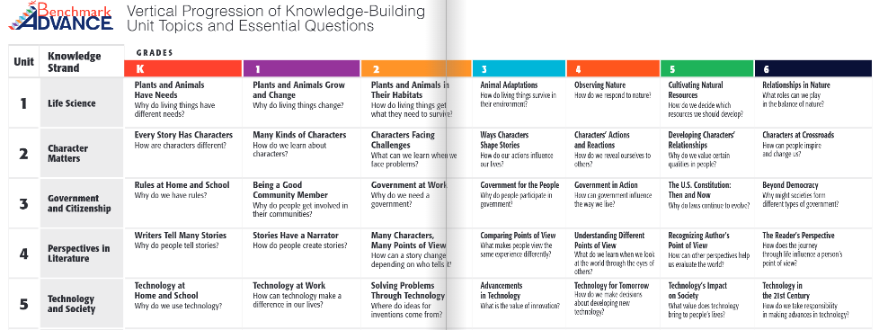

Slide 6
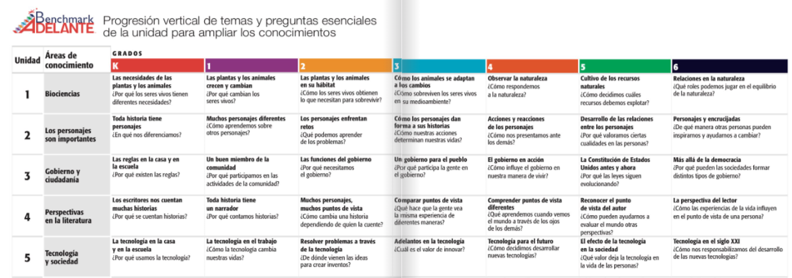

Slide 7
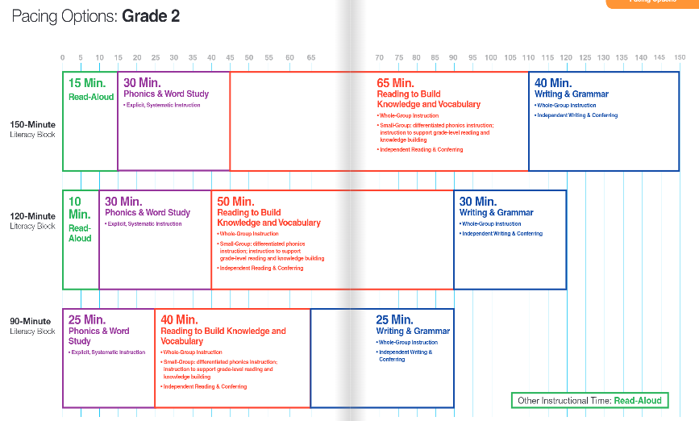

Slide 8
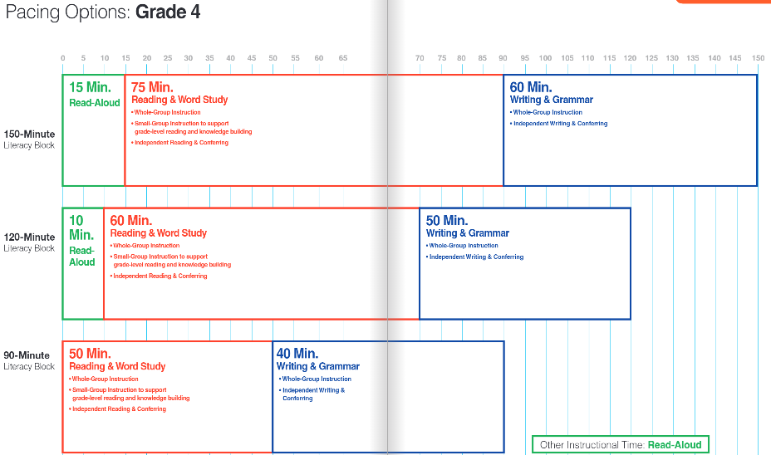

Slide 9
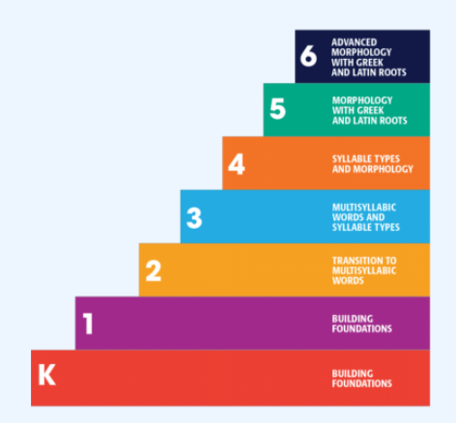
Phonics and Word Study
Explicit
Systematic
Spiral Review

Slide 10
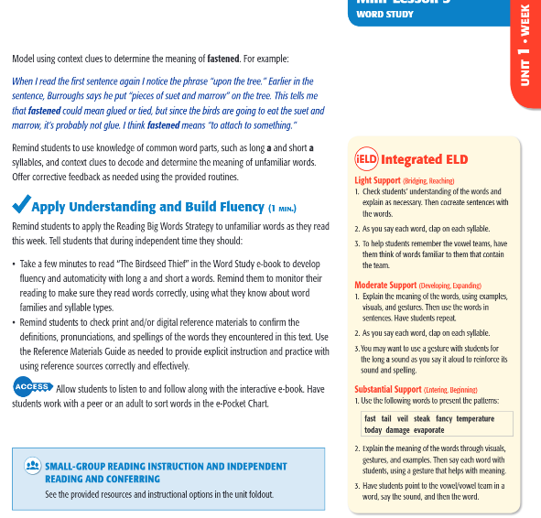
Integrated ELD

Slide 11
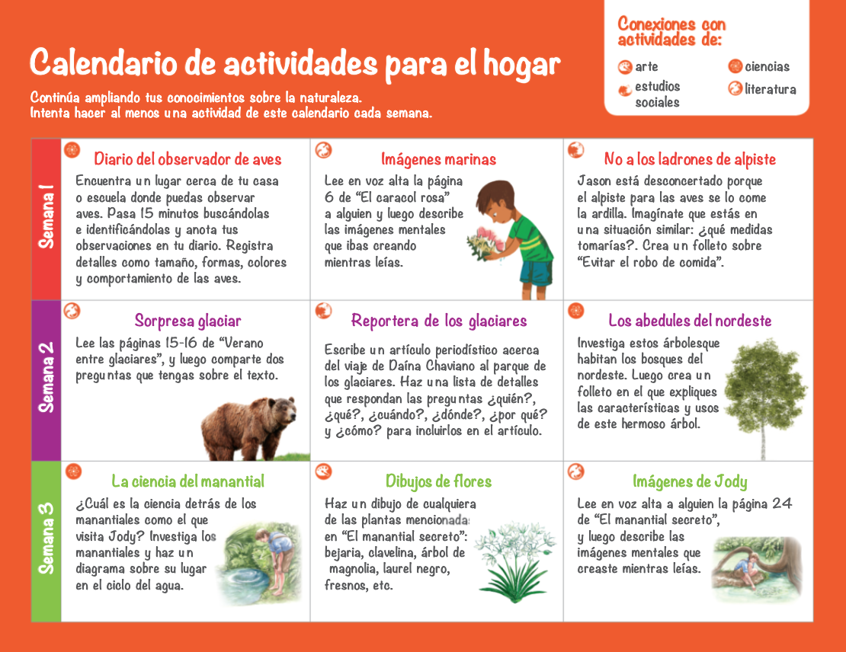
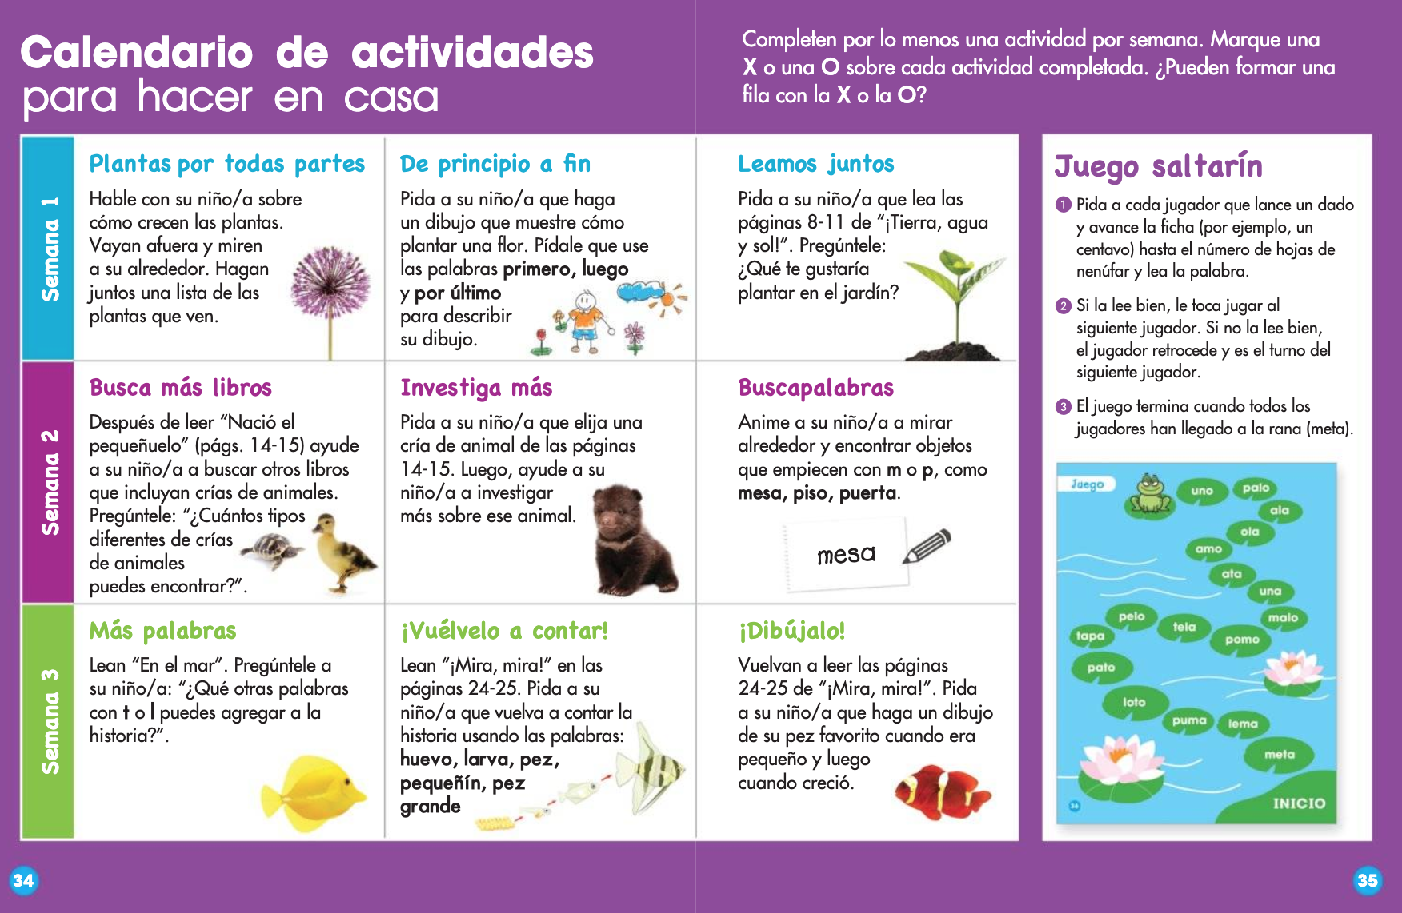
CONNECT
Home-to-School
© Benchmark Education Company, LLC. All Rights Reserved
Notes:
At the end of every 3-week unit, connections continue beyond the walls of school, the My Reading and Writing and the…
CLICK
Texts for Close Reading interactive texts go home with students, which reinforces ownership of both the texts and learning. The Take-Home Activity Calendars show caregivers and students how they can interact together and connect their experiences around the unit topic and even continue learning at home. Our unit introduction letters are available in multiple languages supporting a healthy school -home connection. These materials provide additional fun and inspiring ideas to support the upcoming unit of learning. Families with students in multiple grade levels will appreciate learning similarities making for fun conversations during the car ride home or around the dinner table.

Slide 12
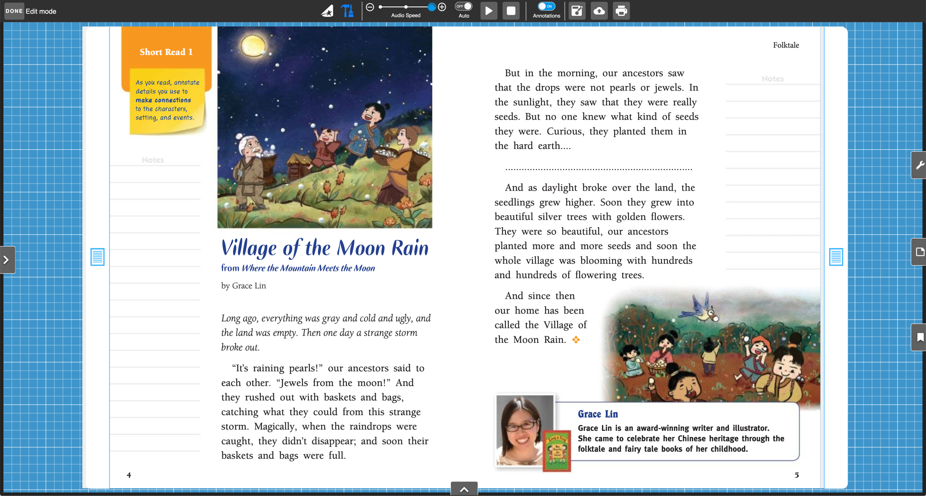
CONNECT
Home-to-School
© Benchmark Education Company, LLC. All Rights Reserved
Notes:
And the student texts are completely interactive digitally for both teachers and students! Students can connect with their learning in their print and digital interactive texts. Benchmark is a one-stop shop for students to engage and connect with their learning.
Play the video and talk about the digital features students will experience.
These texts are all located on Benchmark Universe, which is our online portal. All of these resources are device agnostic, so they work on any device. We even have an app that allows students to access texts off-line. Which is great for those on-the-go students or if we find ourselves in a distance learning space!

Slide 13
CONNECT
Home-to-School
© Benchmark Education Company, LLC. All Rights Reserved
Notes:
We understand the importance of building strong school-home partnerships. Benchmark Universe’s easy to use platform strengthens this connection. You may have received the community engagement flyer that shows what that digital platform looks and sounds like from the students’ perspective. You will see 4 boxes on this easy to navigate page. You can also access this page to see how it works.
Let’s start with Box 1 on the top left. This is the library. Students will have a full library of eBooks that they can read, listen to and engage in additional reading from home.
Box 2 on the top right is where students can access assignments their teacher assigns them.
Box 3 on the bottom right is the reading log that keeps track of books students are reading, which allows students to celebrate their reading growth and track their own progress.
Finally, box 4 in the bottom left is an inbox for messages

Slide 14
LEARN
Build Diverse
Perspectives
F. Isabel Campoy
Derrick Barnes
Joseph Bruchac
Oliver Chin
Shenaaz Nanji
© Benchmark Education Company, LLC. All Rights Reserved
Notes:
Benchmark actually commissioned a diverse group of published trade-book authors to use their rich story-telling skills…
(Click) …
To write our knowledge building text sets for Benchmark Advance.
Authentic literature is provided as anchor texts for whole-group instruction as well. In Kindergarten and grade 1, authentic trade books are provided in the form of Big books and lap books. Our authentic voice texts reflect a team of diverse authors and illustrators who tell their story in their own voice, allowing children to see themselves reflected in texts, as well as learning about others.

Slide 15
LEARN
Build Diverse
Perspectives
René Colato Laínez
Derrick Barnes
Verónica Linares
Rigoberto González
Shenaaz Nanji
© Benchmark Education Company, LLC. All Rights Reserved
Notes:
Benchmark actually commissioned a diverse group of published trade-book authors to use their rich story-telling skills…
(Click) …
To write our knowledge building text sets for Benchmark Adelante and Benchmark Advance.
Authentic literature is provided as anchor texts for whole-group instruction as well. In Kindergarten and grade 1, authentic trade books are provided in the form of Big books and lap books. Our authentic voice texts reflect a team of diverse authors and illustrators who tell their story in their own voice, allowing children to see themselves reflected in texts, as well as learning about others.

Slide 16
GROW
Meet Each
Student
Where
They
Are
© Benchmark Education Company, LLC. All Rights Reserved
Notes:
To be certain students are supported at their specific level of need, Benchmark Advance provides a robust assessment portal. Teachers can pinpoint and target needed instruction and provide specific intervention when appropriate.
This information can be shared easily with parents through the Benchmark Universe platform.

Slide 17
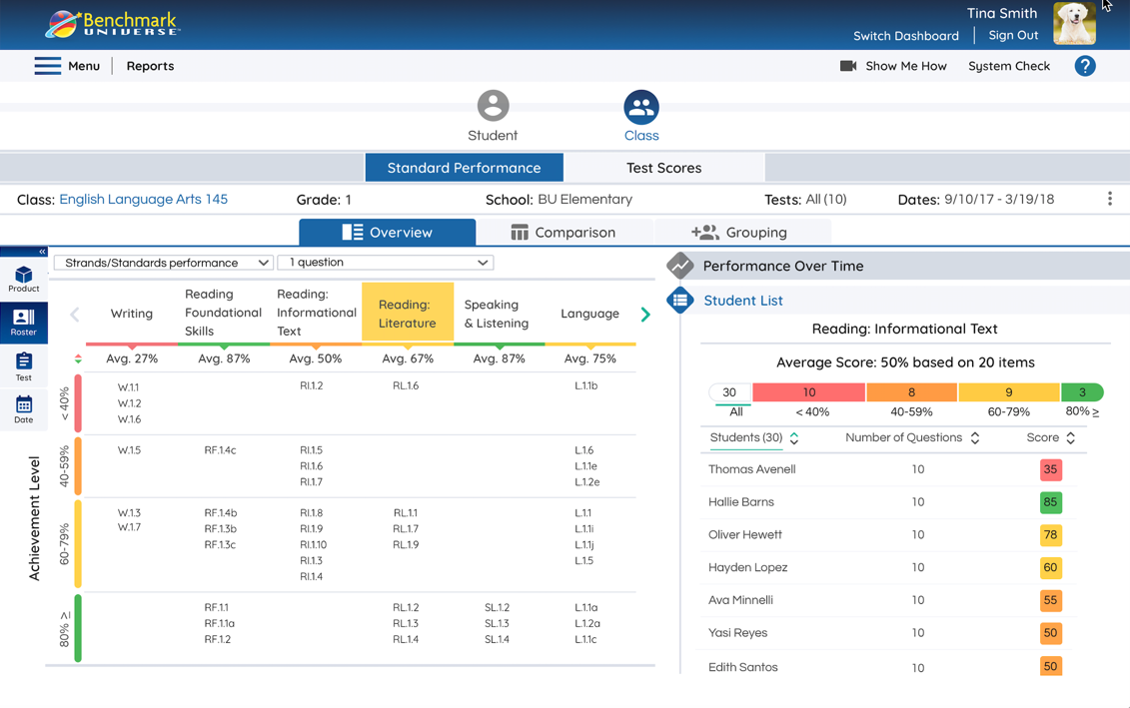
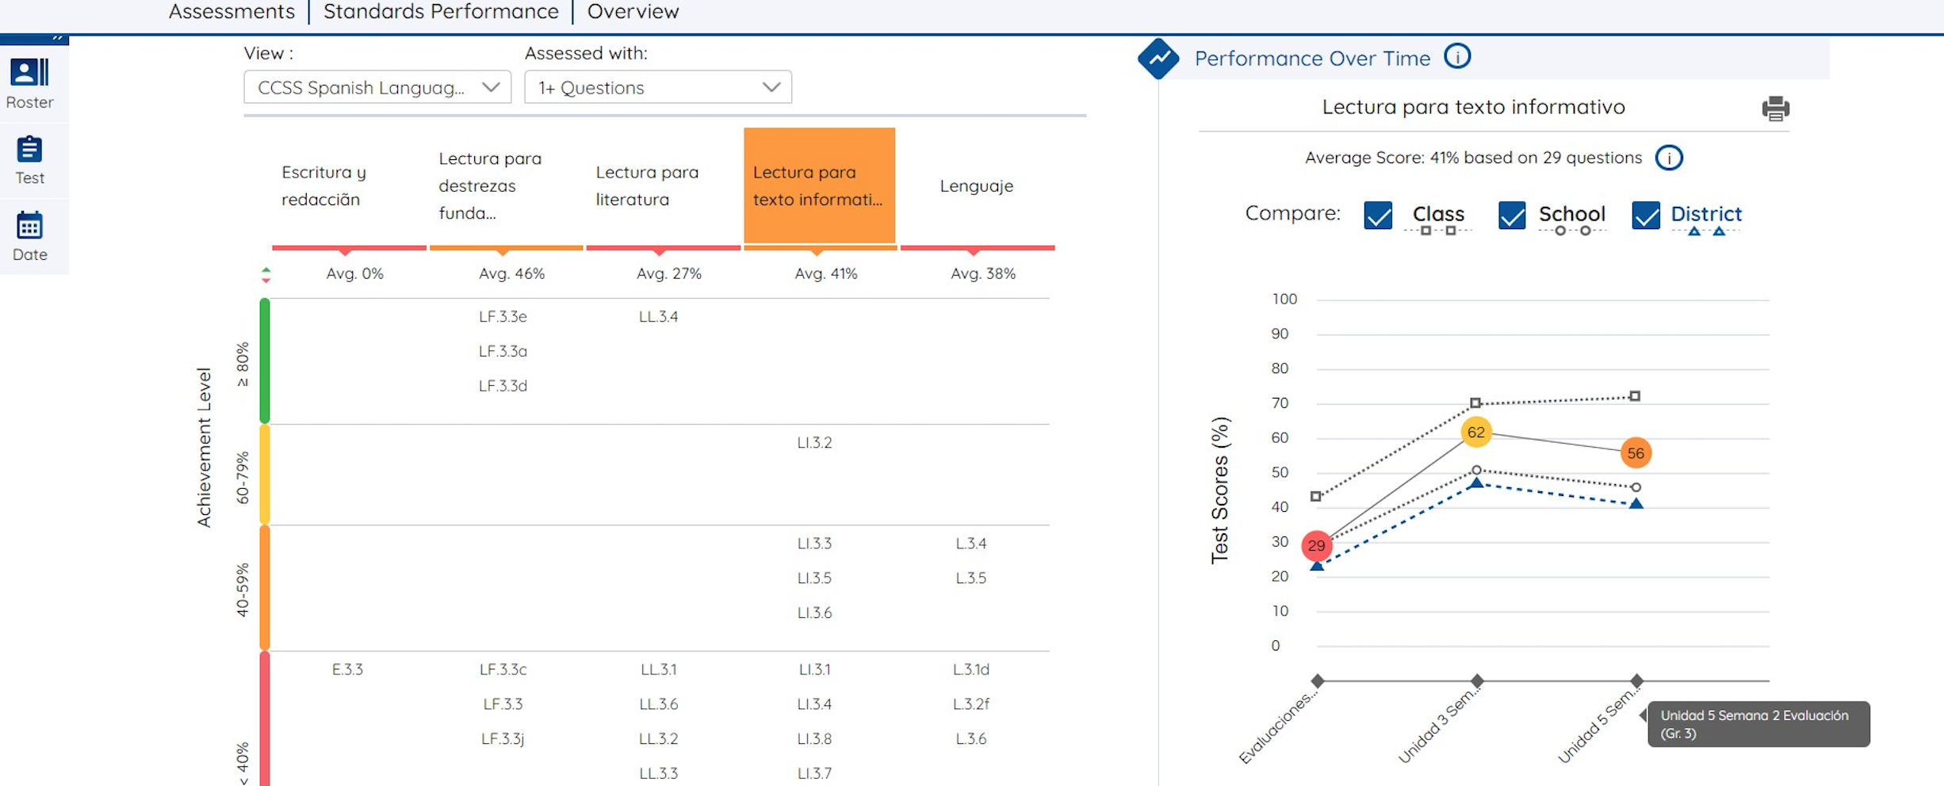
GROW
Meet Each
Student
Where
They
Are
© Benchmark Education Company, LLC. All Rights Reserved
Notes:
To be certain students are supported at their specific level of need, Benchmark Adelante and Benchmark Advance provides a robust assessment portal. Teachers can pinpoint and target needed instruction for both languages and provide specific intervention when appropriate.
This information can be shared easily with parents through the Benchmark Universe platform.

Slide 18
Efficacy Report

Slide 19
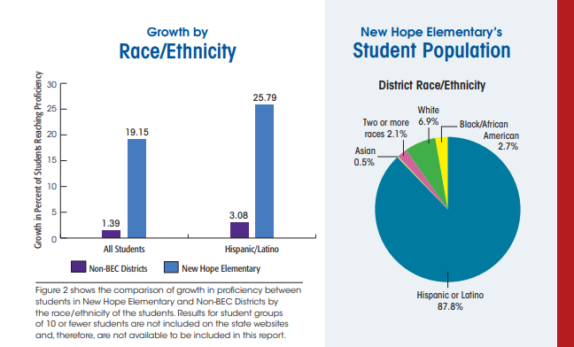
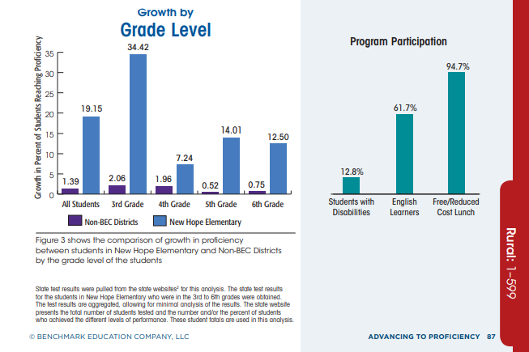
Efficacy Report

Slide 20
Thank you!
© Benchmark Education Company, LLC. All Rights Reserved
Notes:
Thank you for your time today. (Open floor for Q&A)

